Slide 1

SmartSphere Event Management System
Developed by: Ibtisam Shahzad 22i-1201 Ibrahim Asim 22i-1330 Haider Zia 22i-1196

Slide 2
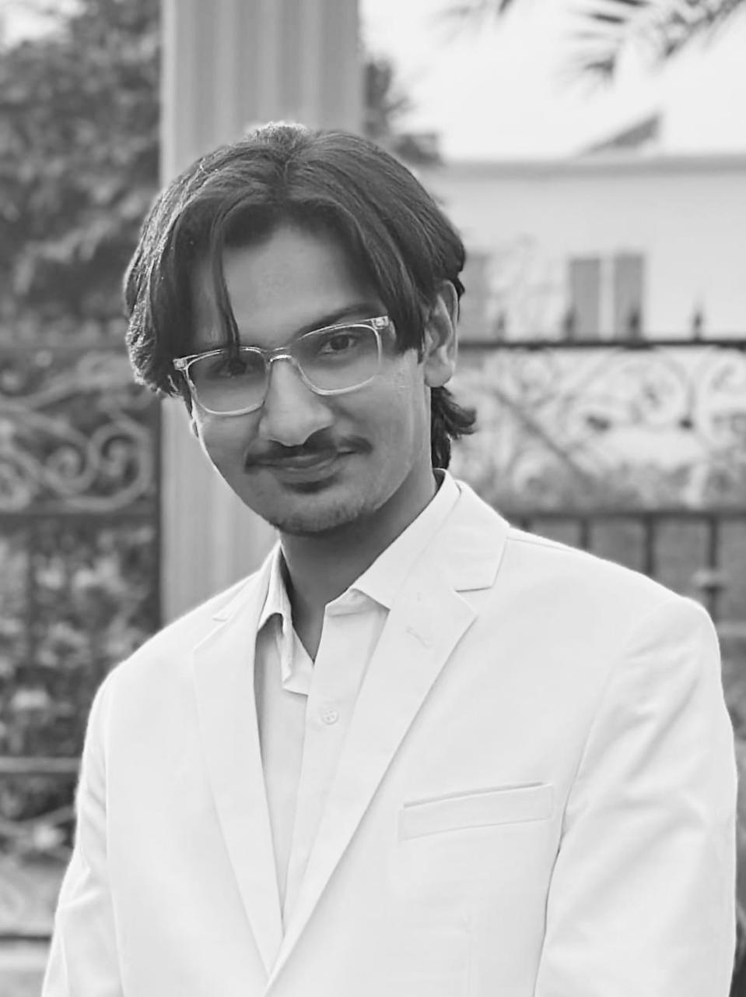
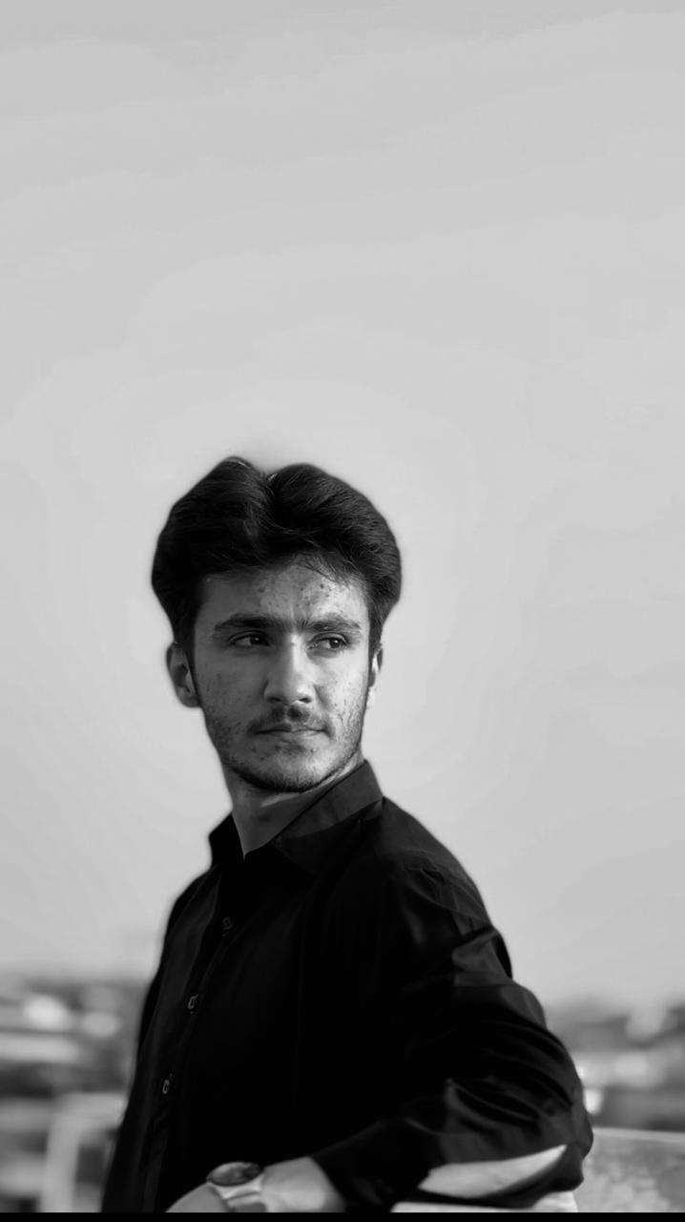

Work Division
Ibtisam Shahzad: Requirements, Architecture Design, Frontend Integration
Haider Zia: Scrum Management, Testing, Documentation
Ibrahim Asim: Backend Development, Database Design, API Integration

Slide 3
Project Introduction
Objective: Simplify event registration, scheduling, feedback, and notifications for NASCON.
Roles: Admin, Organizer, Participant
Technologies: React.js, Spring Boot, MySQL/PostgreSQL
GOALS:
Streamline event workflows for participants, organizers, and admins.
Ensure secure, scalable, and efficient event management.

Slide 4
Functional Requirements
User Authentication
Event Management (Create, Modify, Delete)
Enrollment/Unenrollment in Events
Feedback Submission
Notification System
Admin Reporting

Slide 5
Non-Functional Requirements
System Availability: 99.9%
Data Security: Password encryption with BCrypt

Slide 6
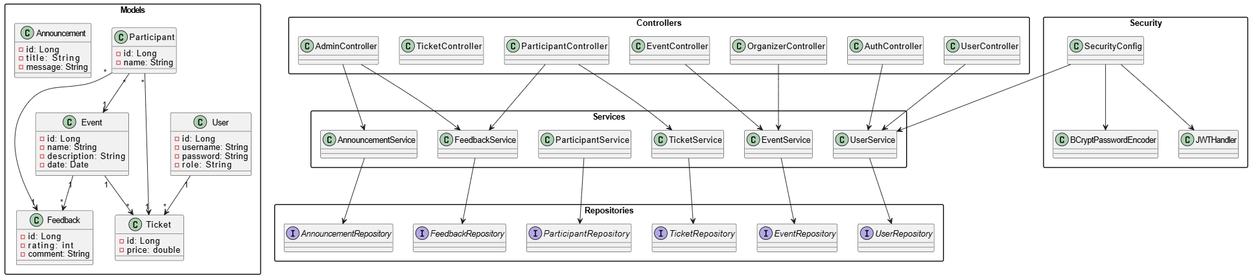
Design - Class Diagram

Slide 7
Architectures
Layered Architecture
MVC (Model-View-Controller)
RESTful APIs
Client-Server Architecture

Slide 8
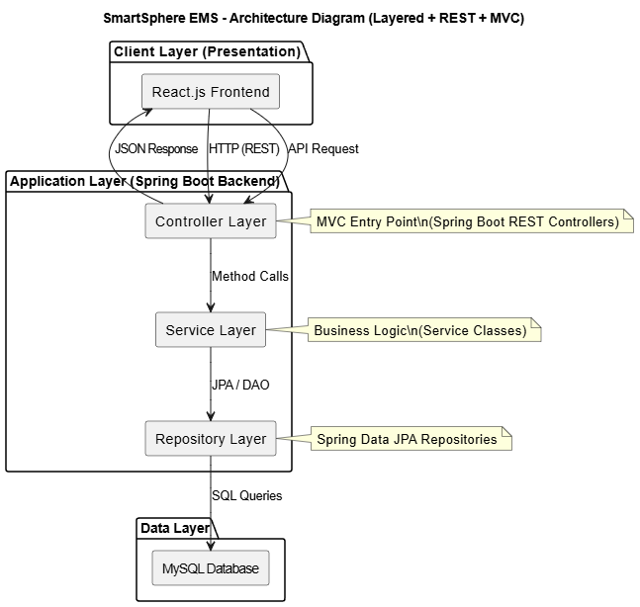
Architecture Diagram

Slide 9
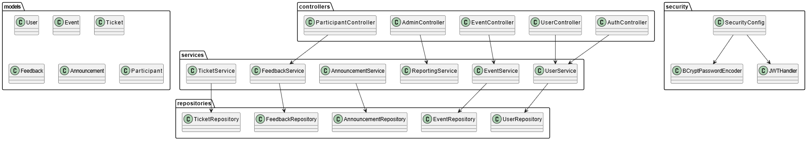
UML-Package Diagram

Slide 10
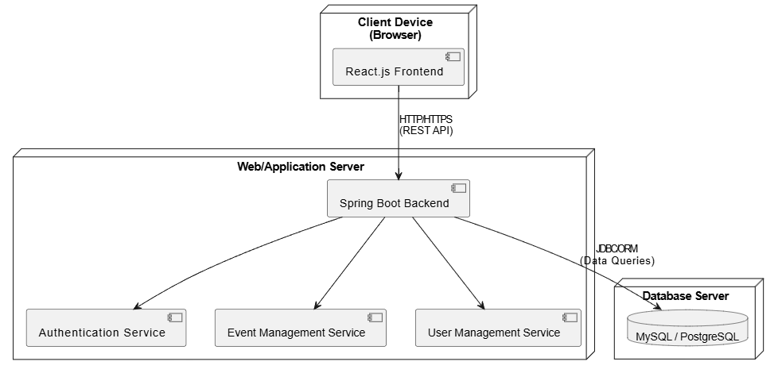
UML-Deployment Diagram

Slide 11
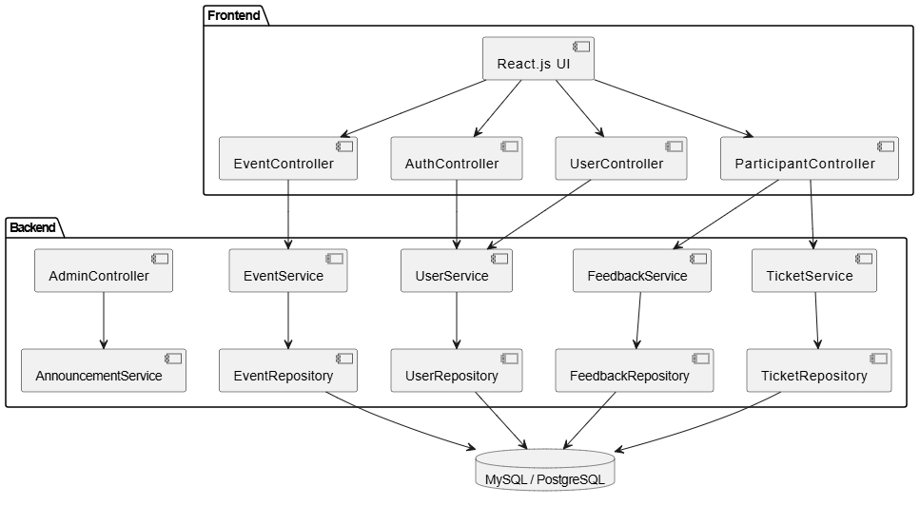
UML-Component Diagram

Slide 12
Project Planner
Main Tasks:
System Design
Frontend Development
Backend Development
Testing
Deployment

Slide 13
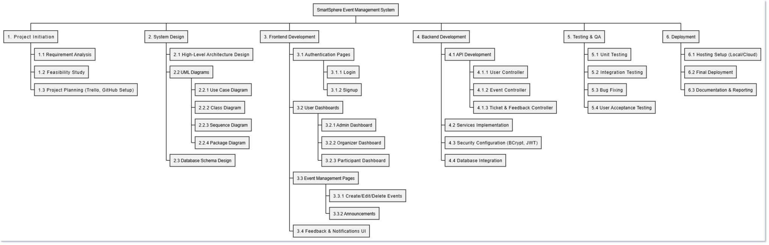
Project Planner -WBS

Slide 14
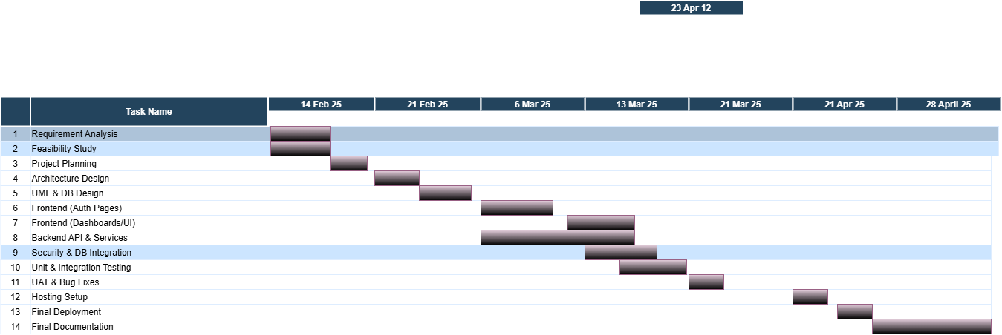
Project Planner -Gantt Chart

Slide 15
Project Planner -Sprint planning
Sprint 1: User Authentication, Event Creation, Enrollment
Sprint 2: Event Modification, Cancellation, Notification System
Sprint 3: Feedback Collection, Reporting, Final Hosting

Slide 16
User Stories Highlights

Slide 17
User Stories-Main User Stories
User Registration and Login
Event Creation and Enrollment
Event Modification and Cancellation
Submit Feedback
View Announcements

Slide 18
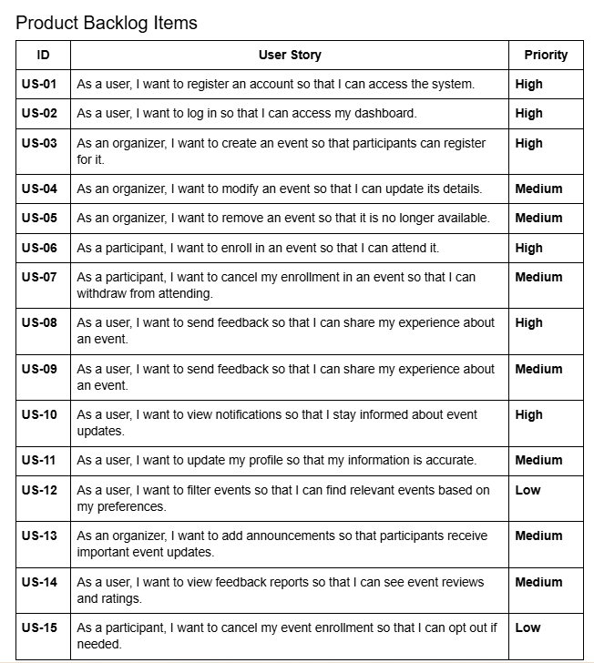
User Stories-Product backLog

Slide 19
Implementation
Snapshots

Slide 20
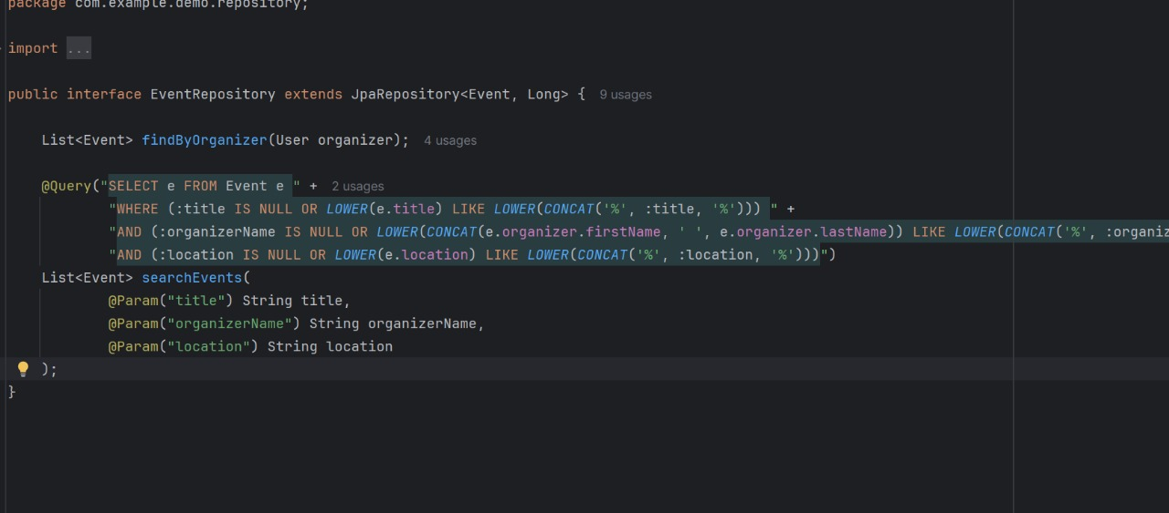
Implementation-Backend

Slide 21
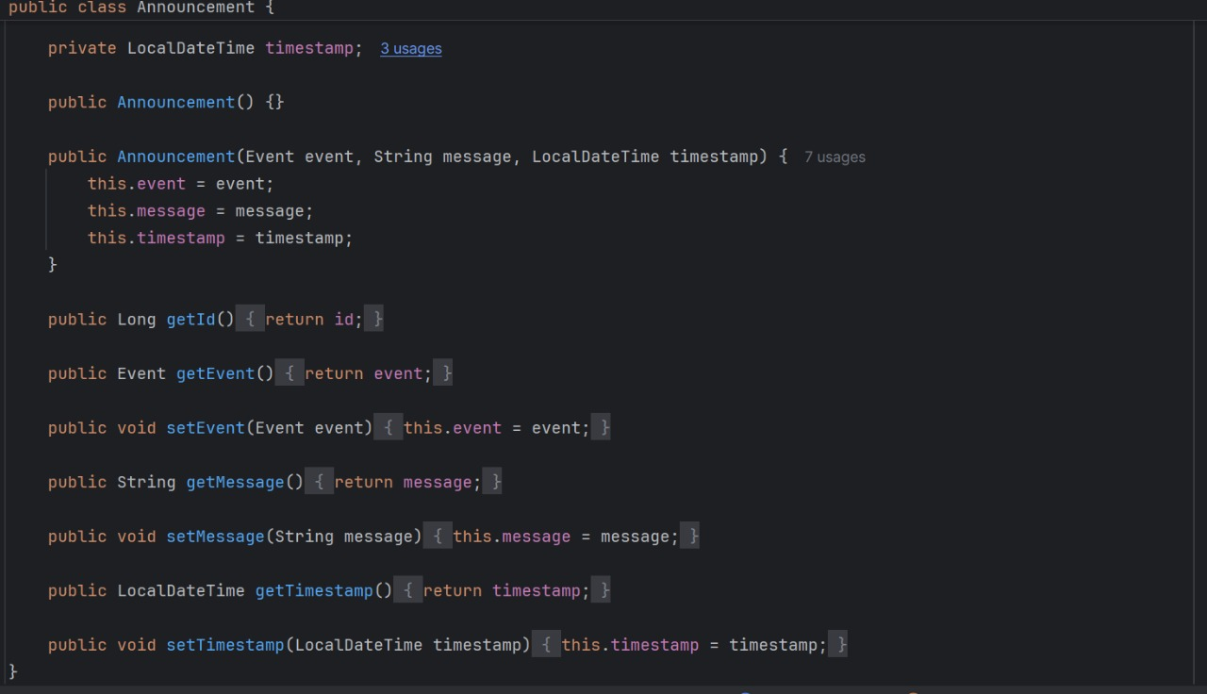
Implementation-Backend(contd)

Slide 22
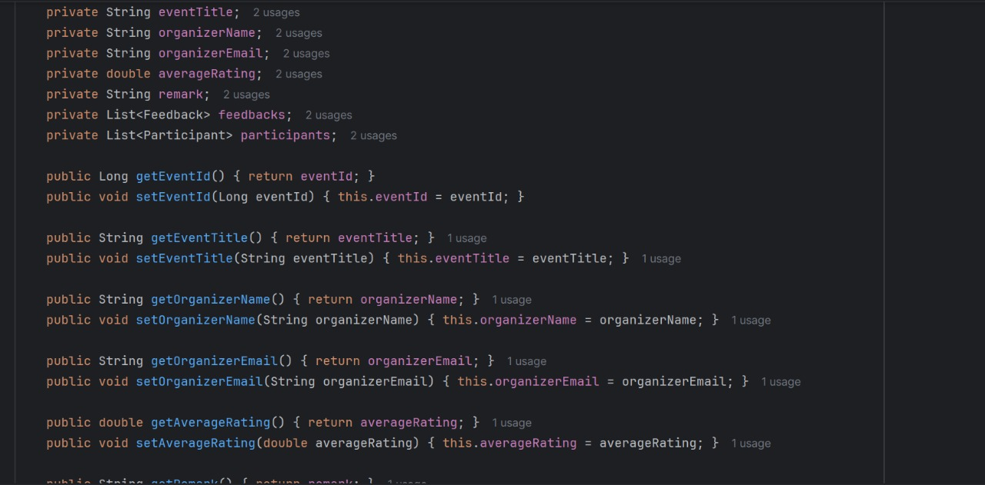
Implementation-Backend(contd)

Slide 23
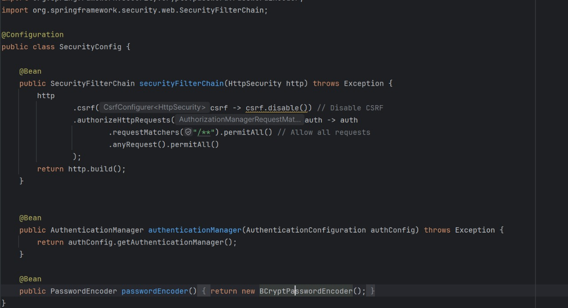
Implementation-Backend(contd)

Slide 24
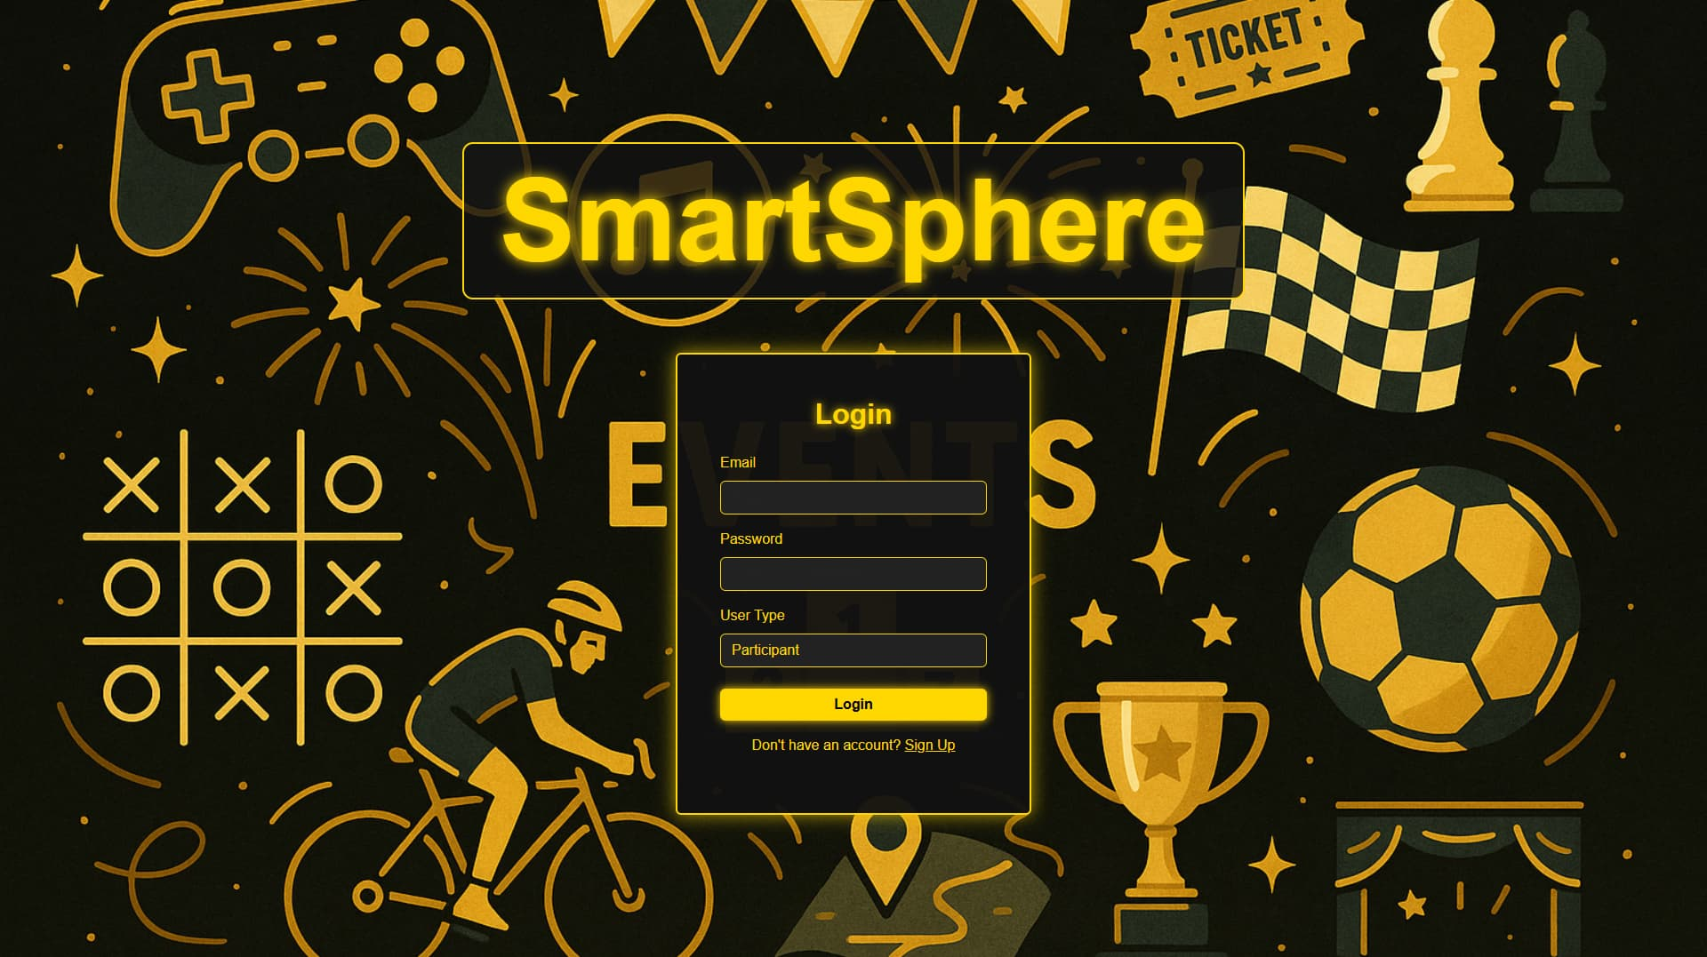
Implementation-FrontEnd (UI)-Login

Slide 25
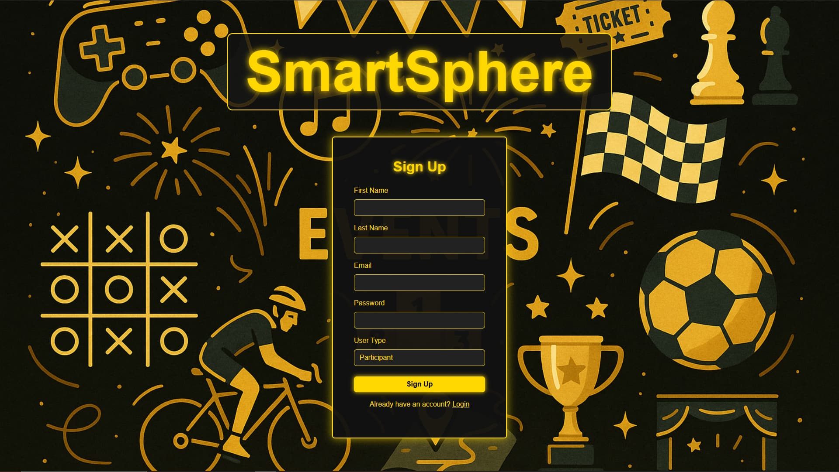
Implementation-FrontEnd (UI)-SignUp

Slide 26
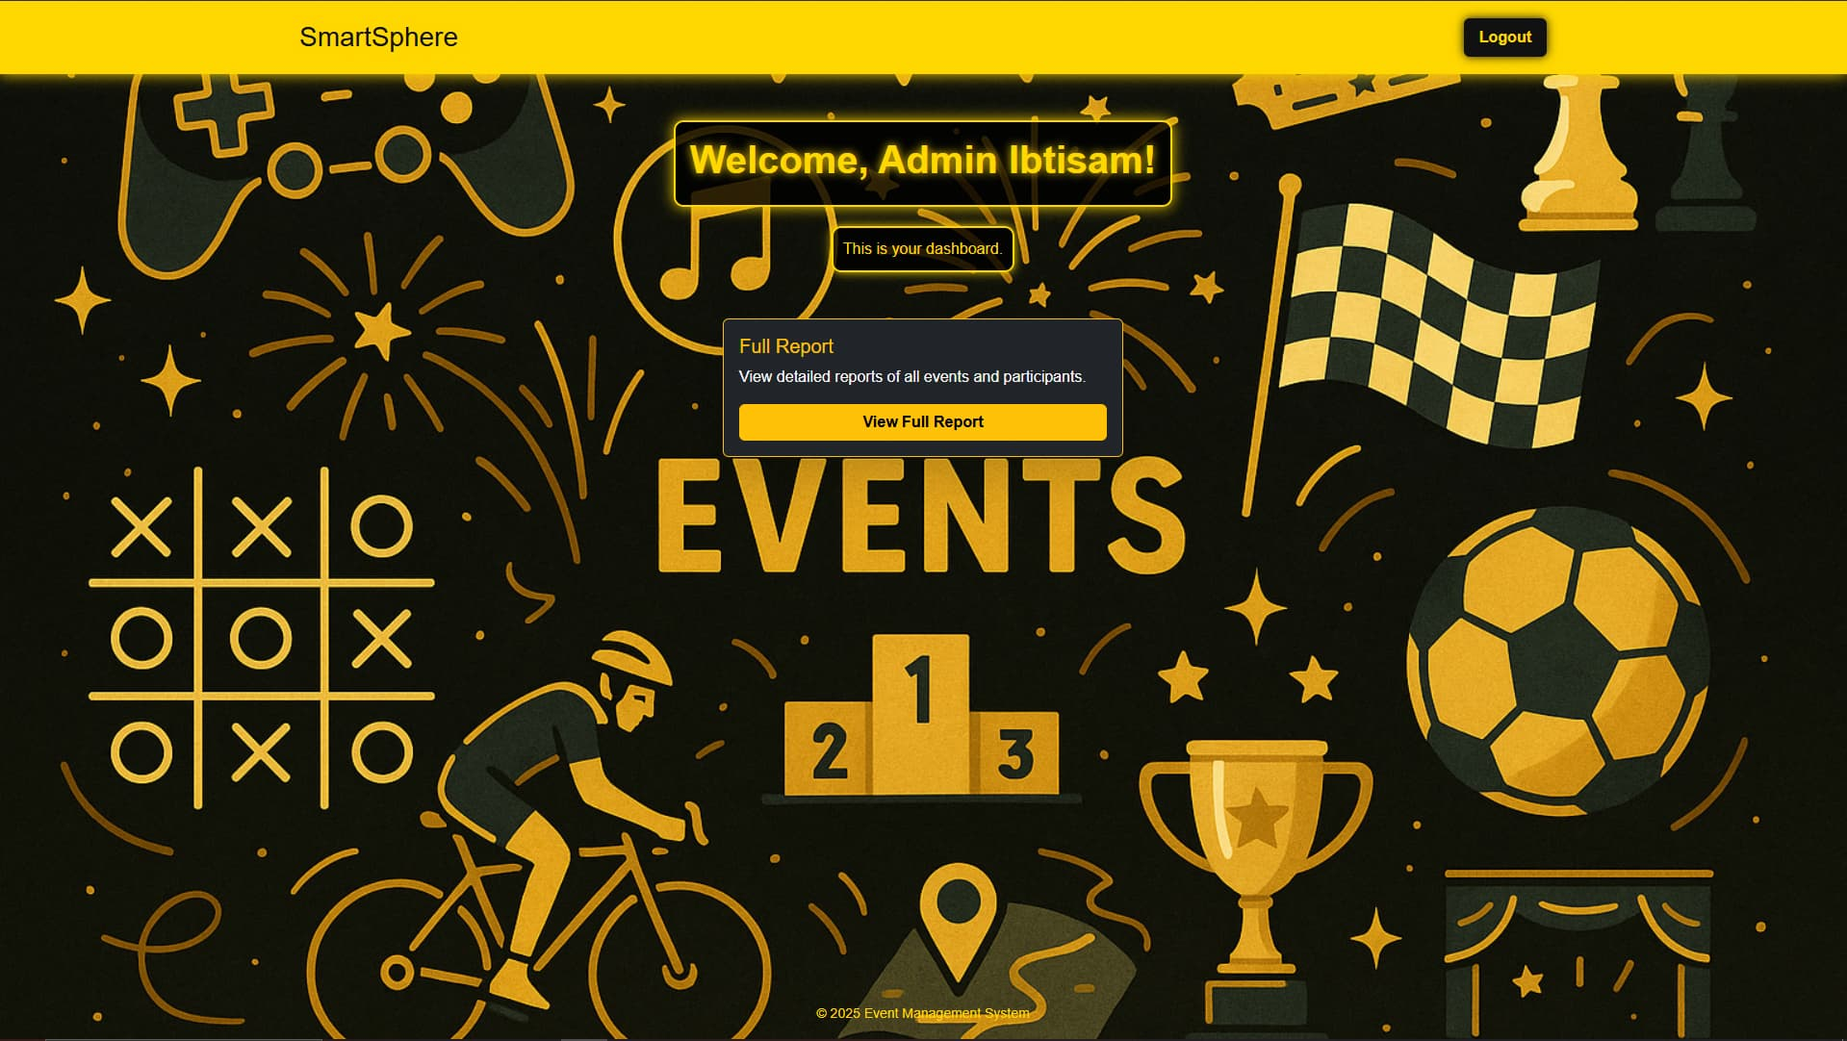
Implementation-FrontEnd (UI)-Admin

Slide 27
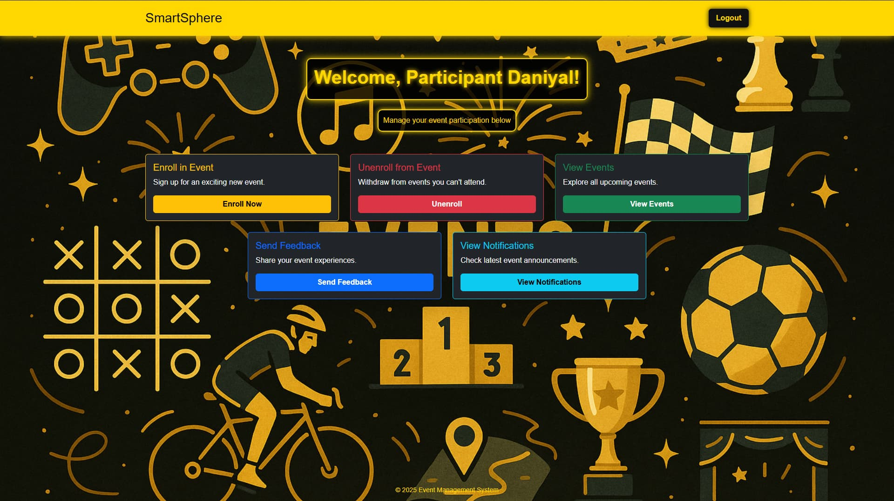
Implementation- FrontEnd (UI)-Participant

Slide 28
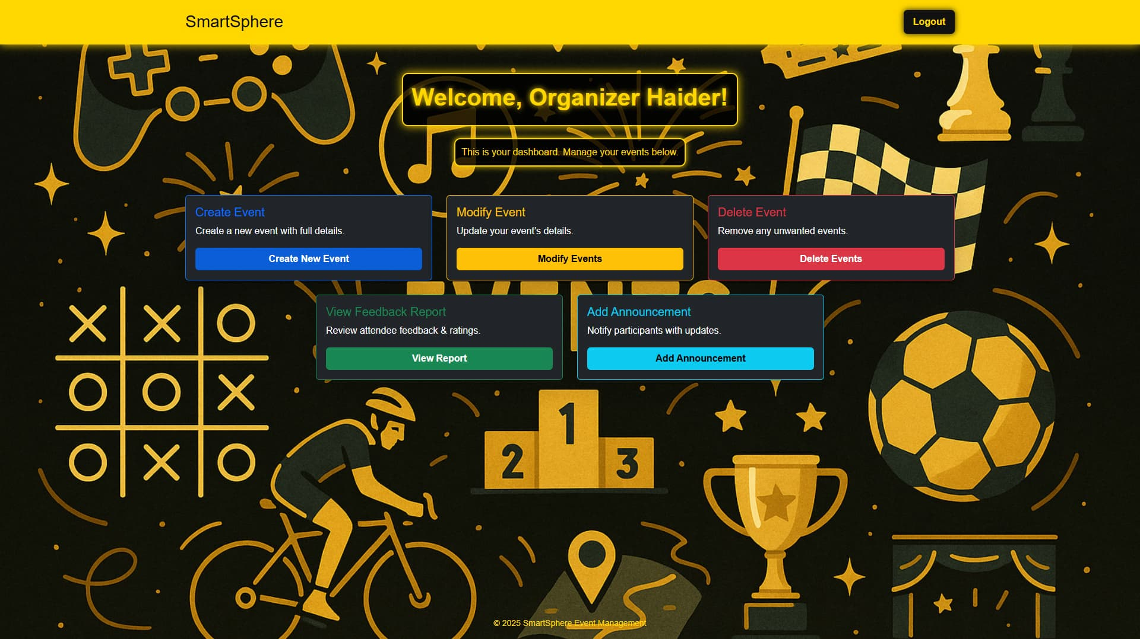
Implementation- FrontEnd (UI)-Organizer

Slide 29
Testing
White Box Testing
Black Box Testing

Slide 30
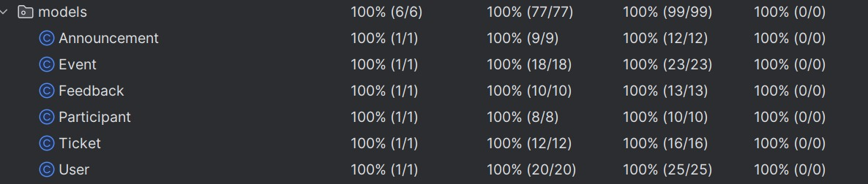
Testing-White Box

Slide 31
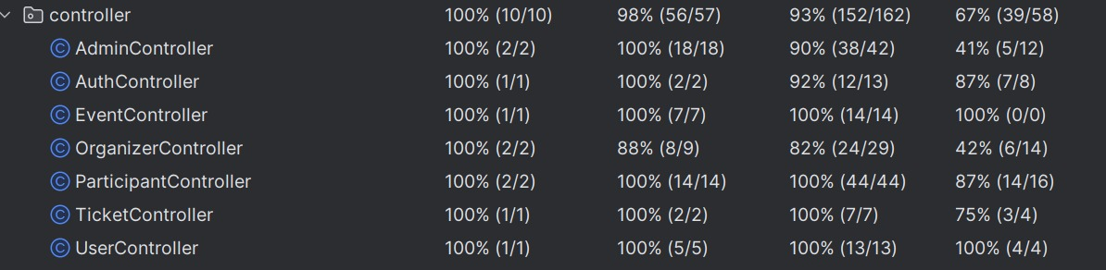
Testing-White Box(contd)

Slide 32
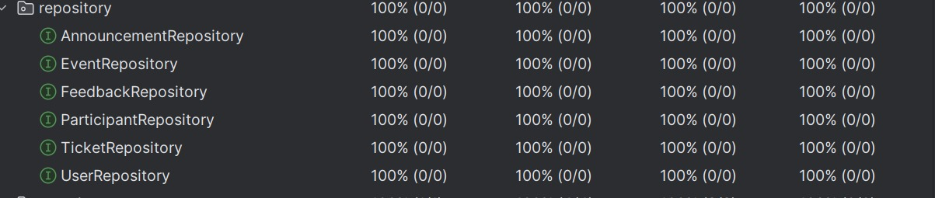
Testing-White Box(contd)

Slide 33
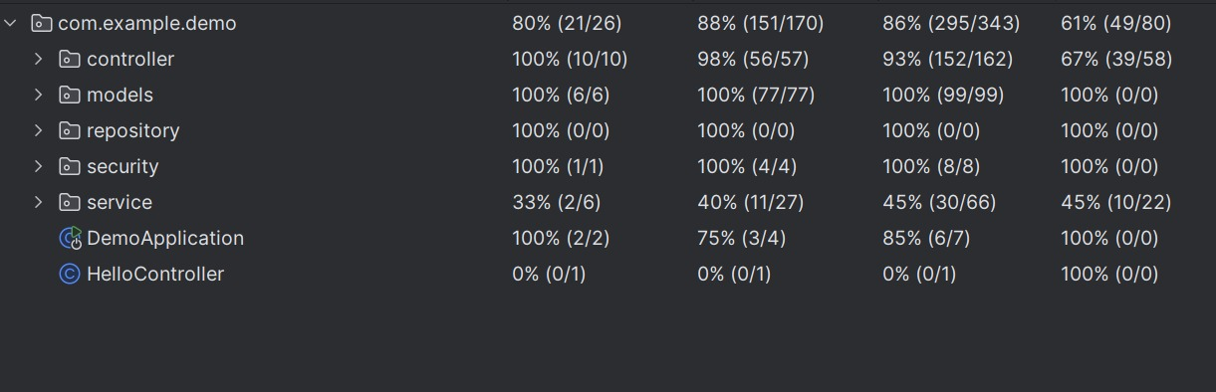
Testing-White Box(contd)

Slide 34
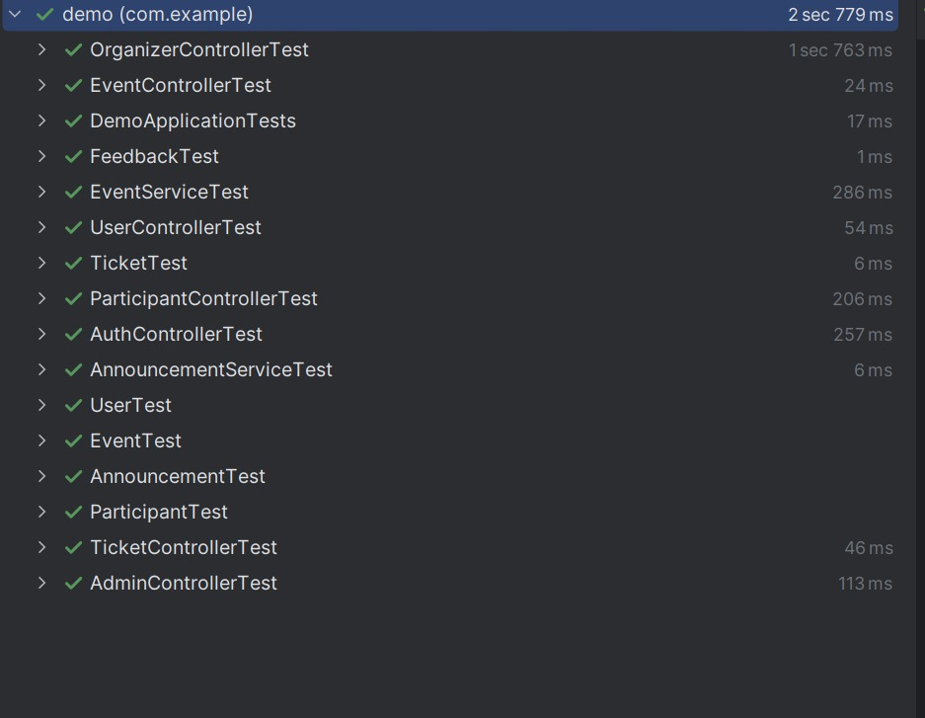
Testing-White Box(contd)

Slide 35
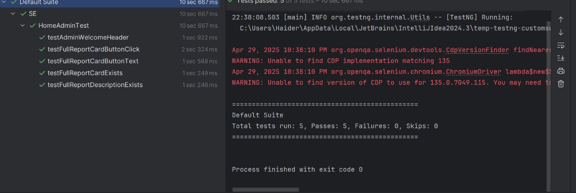
Testing-Black Box

Slide 36
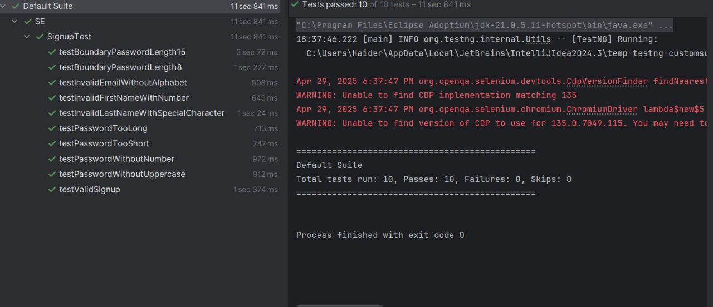
Testing-Black Box(contd)

Slide 37
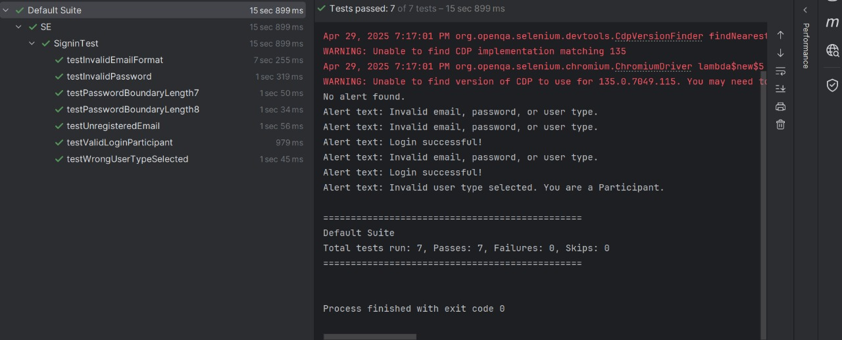
Testing-Black Box(contd)

Slide 38
Improvements:
Add Email Notifications
Real-time Event Updates with WebSocket
Admin Dashboard Enhancements
Event Ticket Payment Integration

Slide 39
Conclusions:
Lessons Learned:
Agile project execution with Scrum methodology.
Deep understanding of full-stack development.
Improved teamwork, communication, and technical skills.
Final Thoughts:
Successfully built and deployed a scalable event management system.

Slide 40
Thank you for your attention!

